Slide 1
OPEN ELECTIVE
OCS1903 - PROGRAMMING USING PYTHON
WEEK 8 - SET

Slide 2
CONTENTS
Set
Set Creation
Set Methods
Set Operations
Frozenset

Slide 3


Set-{}
A Python set is the collection of the unordered heterogenous items.
Set elements are unique. Duplicate elements are not allowed.
A set is mutable, but the elements contained in the set must be of an immutable type.
There is no index attached to the elements of the set.
Set is mutable but its element must be immutable
Eg:{2,4,1,7,8,9}

Slide 4
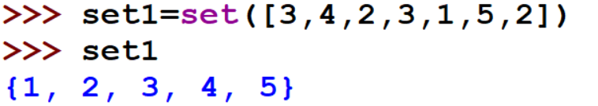
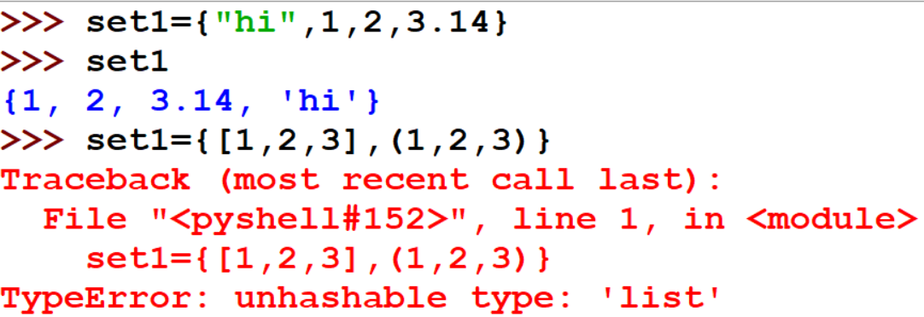

Set Creation
The set can be created by enclosing the comma-separated immutable items with the curly braces {}.
Python also provides the set() method, which can be used to create the set by the passed sequence.
This Cleary shows that a set contains unordered and unique elements

Slide 5

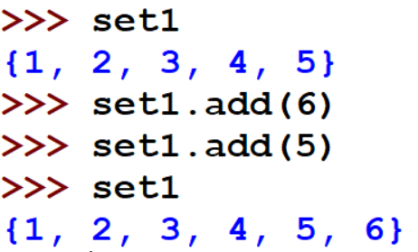
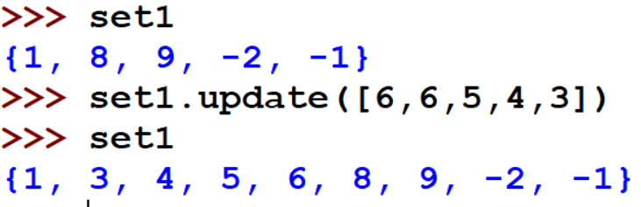

Built-in method-Adding Elements
The add() method is used to add a single element to the set.
Adding Element
The update() method is used to add multiple elements to the set

Slide 6
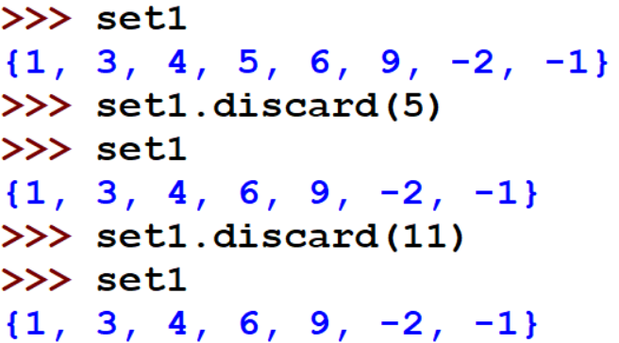
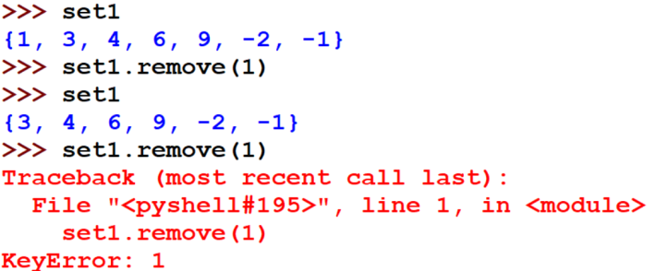

Built-in method-Deleting Elements
The discard method is used to remove an item from the set.
Deleting
Element
The remove method is used to remove an item from the set

Slide 7
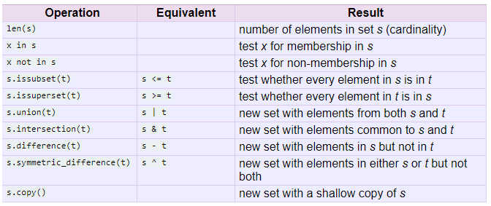
Python Set Operations

Slide 8


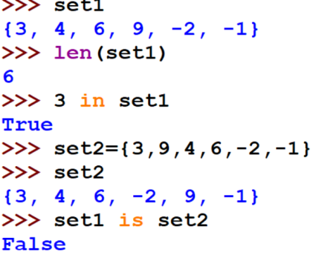

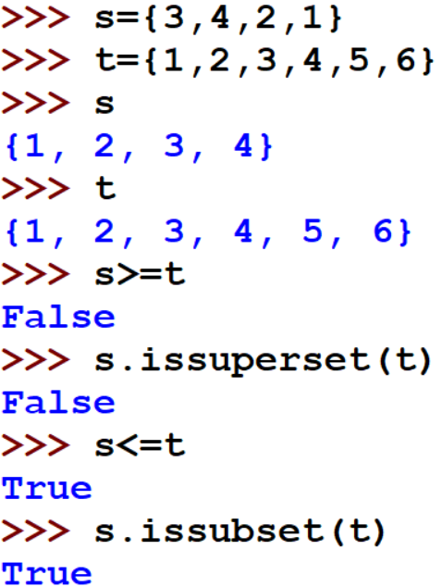
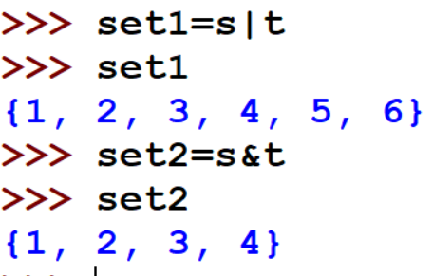
Python Set Operations
Size membership and identity
Superset and subset
Union and Intersection

Slide 9
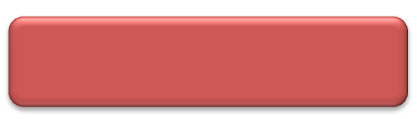

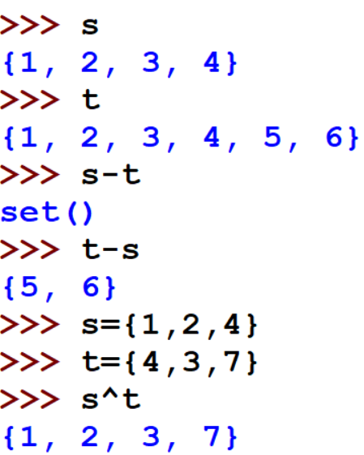
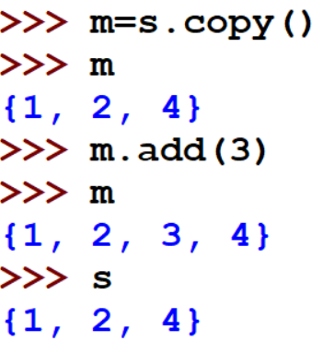
Python Set Operations
Difference and Symm-Difference
Copy()

Slide 10
Frozenset
The frozen sets are the immutable form of the normal sets.
The elements of the frozen set cannot be changed after the creation.
We cannot change or append the content of the frozen sets by using the methods like add() or remove().
The frozenset() method is used to create the frozenset object.
The iterable sequence is passed into this method which is converted into the frozen set as a return type of the method.

Slide 11
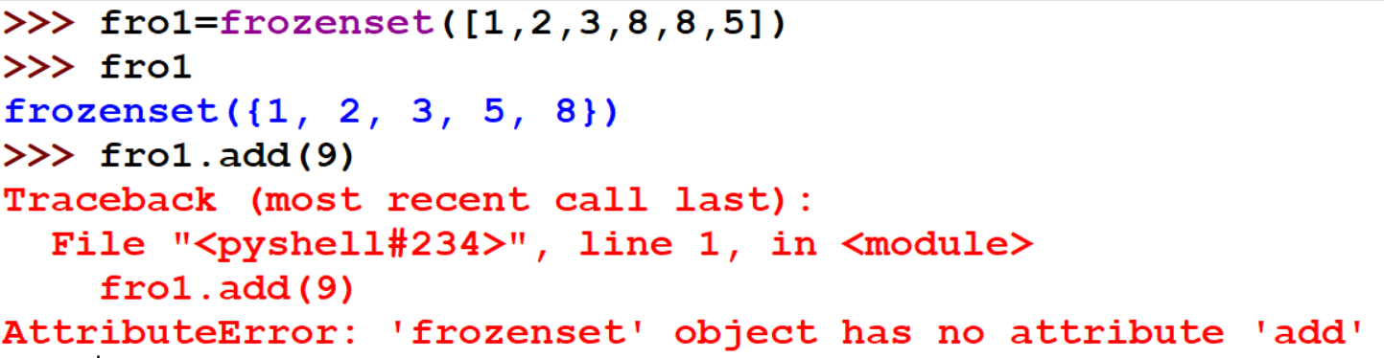
Frozenset

Slide 12

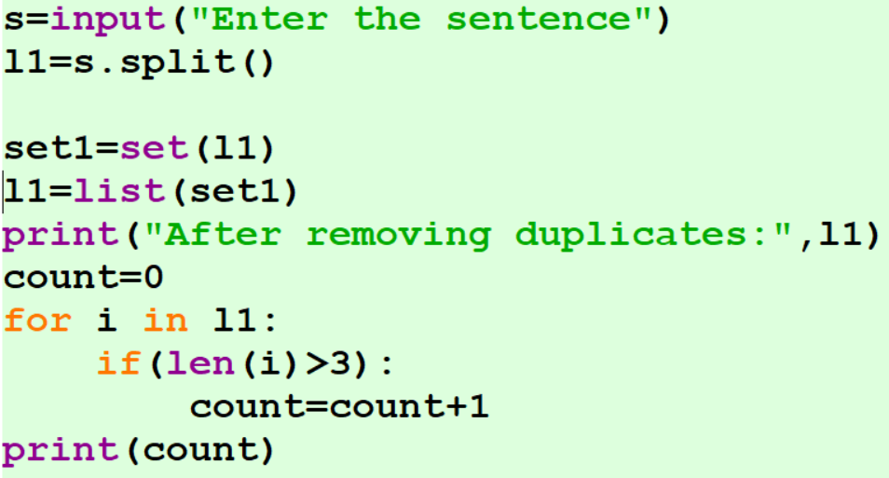
Write a Python program that takes a complete sentence as an input and remove duplicate word in it and then counts all the words which have a length greater than 3.
Example 1
Input:
“we are good are we good”
Output:
we are good
Count=1

Slide 13
Write a Python program to return a new set with unique items from both sets by removing duplicates.
Example 2
Input:
set1 = {10, 20, 30, 40, 50}
set2 = {30, 40, 50, 60, 70}
Output:
{70, 40, 10, 50, 20, 60, 30}
set1 = {10, 20, 30, 40, 50}
set2 = {30, 40, 50, 60, 70}
print(set1.union(set2))

Slide 14
Write a Python program to create an intersection of sets.
Example 3
Program:
setx = set(["green", "blue"])
sety = set(["blue", "yellow"])
print("Original set elements:")
print(setx) print(sety)
print("\nIntersection of two said sets:")
setz = setx & sety print(setz)
Output:
Original set elements:
{'green', 'blue'}
{'blue', 'yellow'}
Intersection of two said sets:
{'blue'}

Slide 15
Write a Python program to use of frozensets.
Note: Frozensets behave just like sets except they are immutable.
Example 4
Program:
x = frozenset([1, 2, 3, 4, 5])
y = frozenset([3, 4, 5, 6, 7])
print(x.isdisjoint(y))
print(x.difference(y))
print(x | y)
Output:
False
frozenset({1, 2})
frozenset({1, 2, 3, 4, 5, 6, 7}

Slide 16


